Slide 1

Machine learning Solution
Sunitha Radhakrishnan
21.12.2020

Slide 2
AGENDA
CRISP DM: Business Understanding
Data Understanding and Description
Data Preperation
Design Architecture
Feature Engineering and Modelling
MLFlow UI
Evaluation and Results
Conclusion and Future Work

Slide 3
Business Understanding
Goal:
To predict the product demand for various categories in different regions
Develop and Implement a solution architecture for customers in pre-sales workshop.
From a data mining perspective: Regression Problem
Success Criteria: Improve Customer Satisfaction
Technology:
Python
MLFlow
Machine Learning Libraries

Slide 4
DATA UNDERSTANDING
Data Source- Kaggle Repository: https://www.kaggle.com/apoorvaappz/global-super-store-dataset
No.of.records: 51290
No.of.columns: 24
Possess both Continous and Categorical variables.
Target Variable to Predict: `Quantity´ for this business use case.
Data Granularity level: Product Level.

Slide 5
DATA PREPERATION
Data Selection:
Dropped the columns that are not relevant for Business Use case: (Customer related information)
Row ID, Order ID, Customer ID, Customer Name, City, State, Country, Postal code.
Data Cleaning:
Dropped missing values, checked for strings, NAN‘s in data.
Feature Creation and selection:
New variables: Order Month, Price, Days to ship product were created that would be helpful for this use case.
Pearsons Feature Correlation – To select features
Data Preprocesing:
Finally the data containing string / categorical values was changed to numerical quantities. Important step, as the model cannot understand string data type.

Slide 6
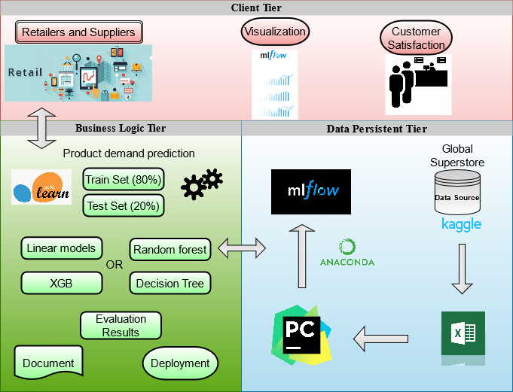
DESIGN ARCHITECTURE

Slide 7
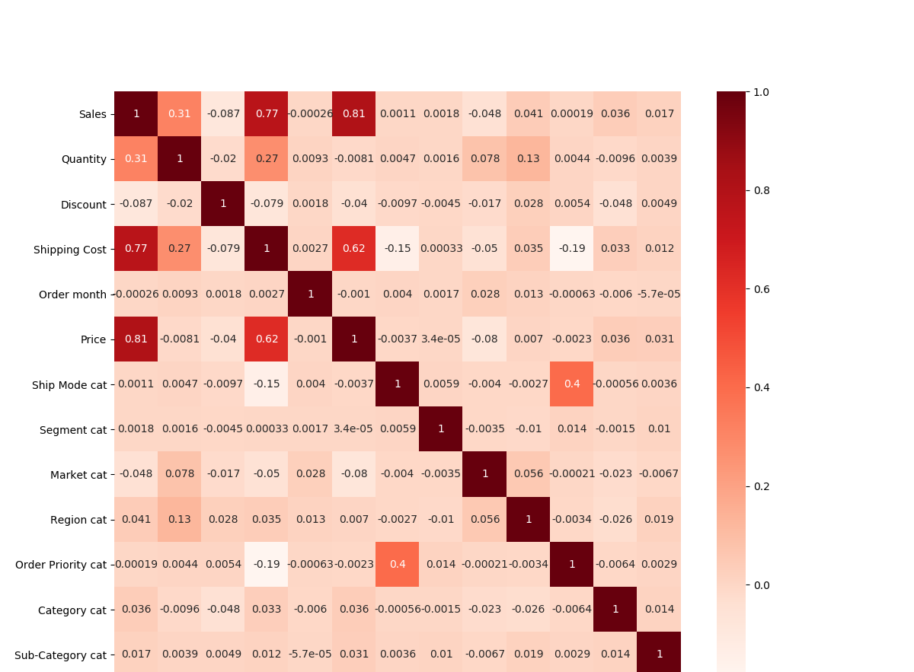
Feature Correlation
To check how many variables / fields are correlated.
For a good model, its better to always have uncorrelated features.
How to find ?
If value > 0.6 → Highly correlated
So here ‘Price’ and ‘Sales’ are highly correlated

Slide 8
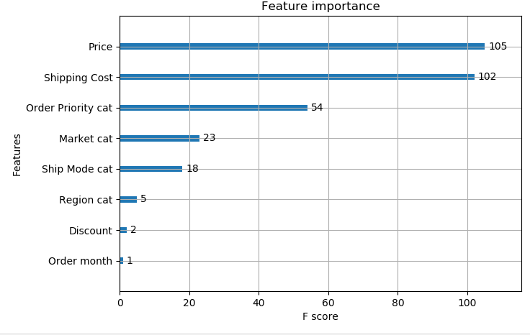
Feature Importance
The plot shows the important variables from XGB feature importance function.

Slide 9
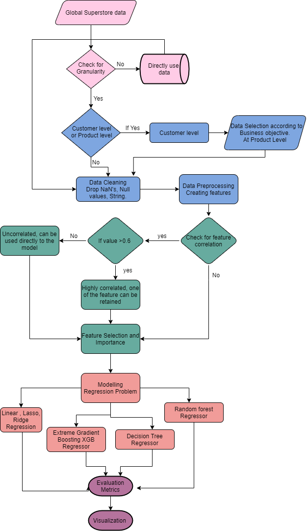
Implemented flow Diagram

Slide 10
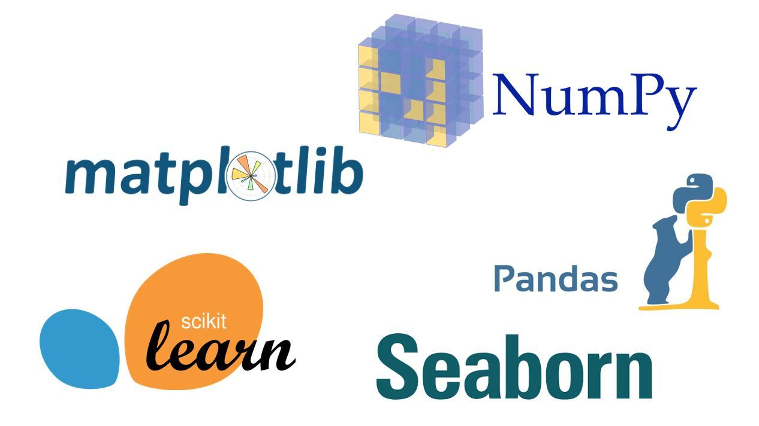
Modelling Algorithms
As the data was non-linear, the following tree based algorithms were implemented in python.
XGB Regression
Random Forest Regression
Decision Tree Regression
Metrics such as RMSE, MSE, MAE, R2 were evaluated against the model.
Data Visualization and tracking was done on MLFLOW UI

Slide 11

MLFLOW
MLFLow - open-source platform responsible for the complete machine learning lifecycle. It has four main components:
MLFlow Tracking – To track experiments , log parameters, artifacts and visualize results in this tracking server.
MLFlow Projects – The complete ML Code can be saved as a project in a reusable , reproducible form inorder to run on any platforms
MLFlow Models – To deploy machine learning models in any different remote environments. Eg: Databricks, Docker, AWS Sagemaker, Azure,etc.
MLFlow Model Registry – To store, manage and discover the models in a repository

Slide 12
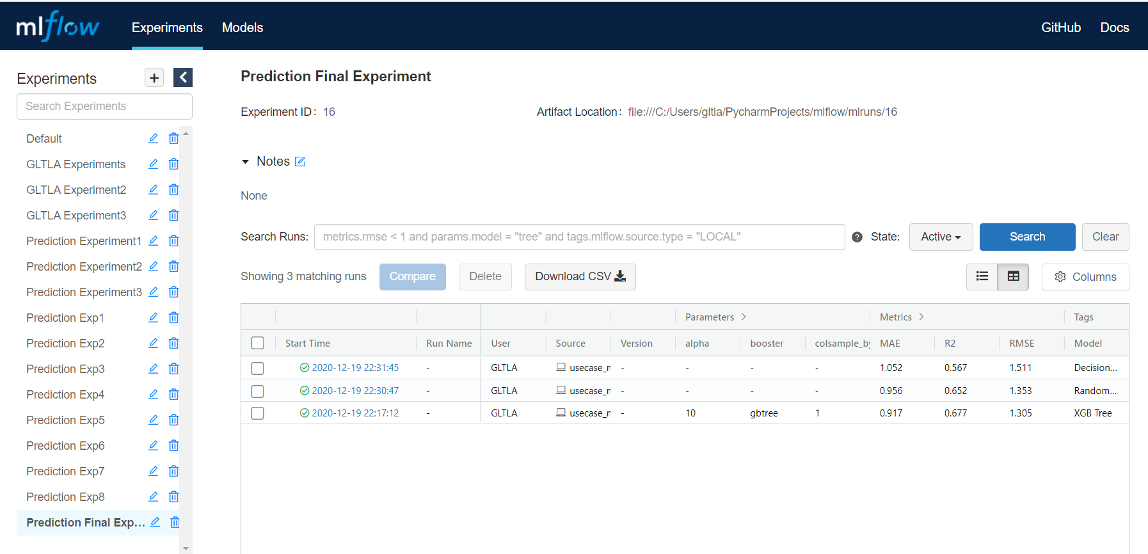
MLFLOW TRACKING UI
log_params()
log_metrics()
with mlflow.log_run()
Setting tags

Slide 13
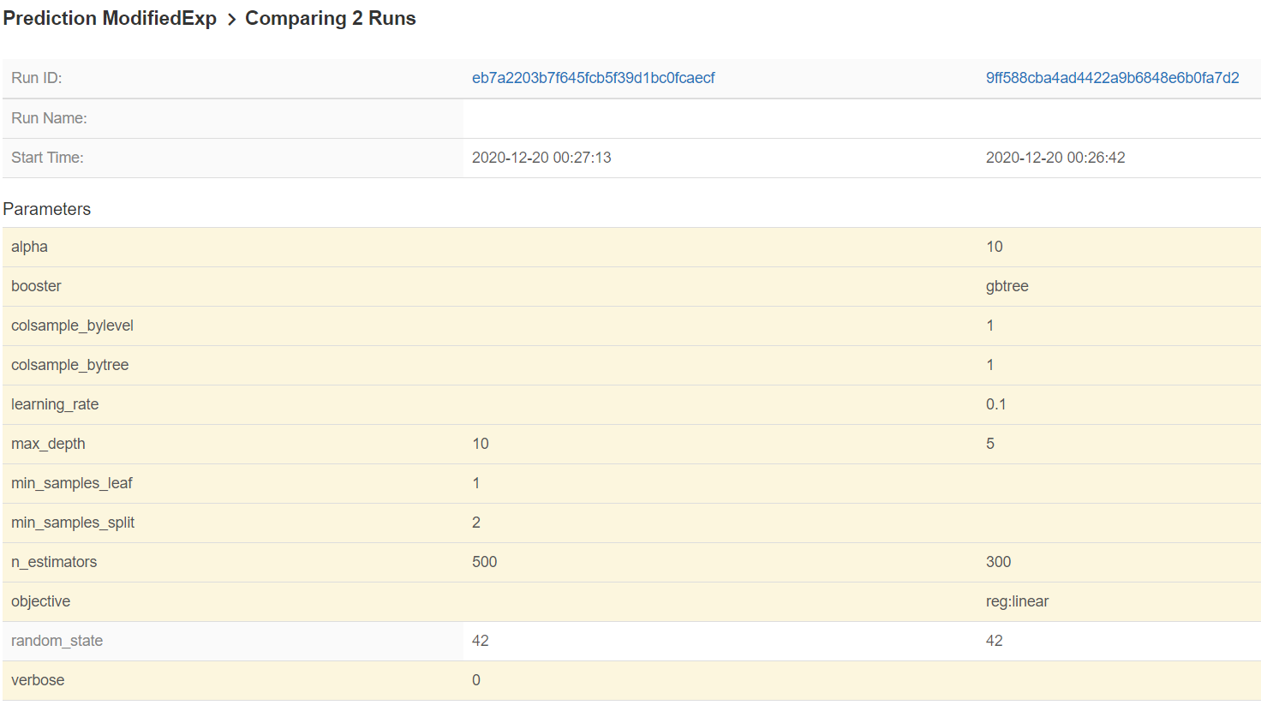
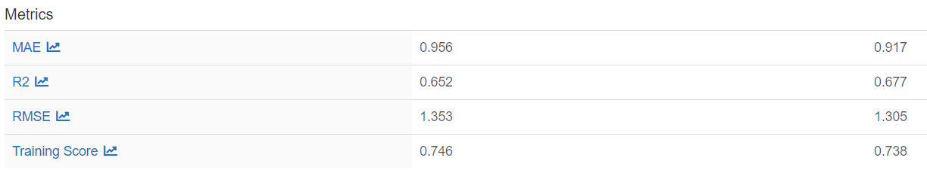
Comparing 2 runs in mlflow : params, metrics are visualized for 2 different models(XGB & RF)
RF Model
XGB Tree Model

Slide 14
Evaluation and Results
Three different models were evaluated and metrics are tabulated for train and test score.
From this table, XGB Regression Algorithm performed well for this business use case.
The model performance was 67% for this business use case.
MODEL | Training Score | MSE | RMSE | MAE | R2
XGB Regressor | 0.73 | 1.70 | 1.30 | 0.91 | 0.67
Random Forest | 0.74 | 1.83 | 1.35 | 0.95 | 0.65
Decision Tree | 0.69 | 2.28 | 1.51 | 1.05 | 0.56

Slide 15
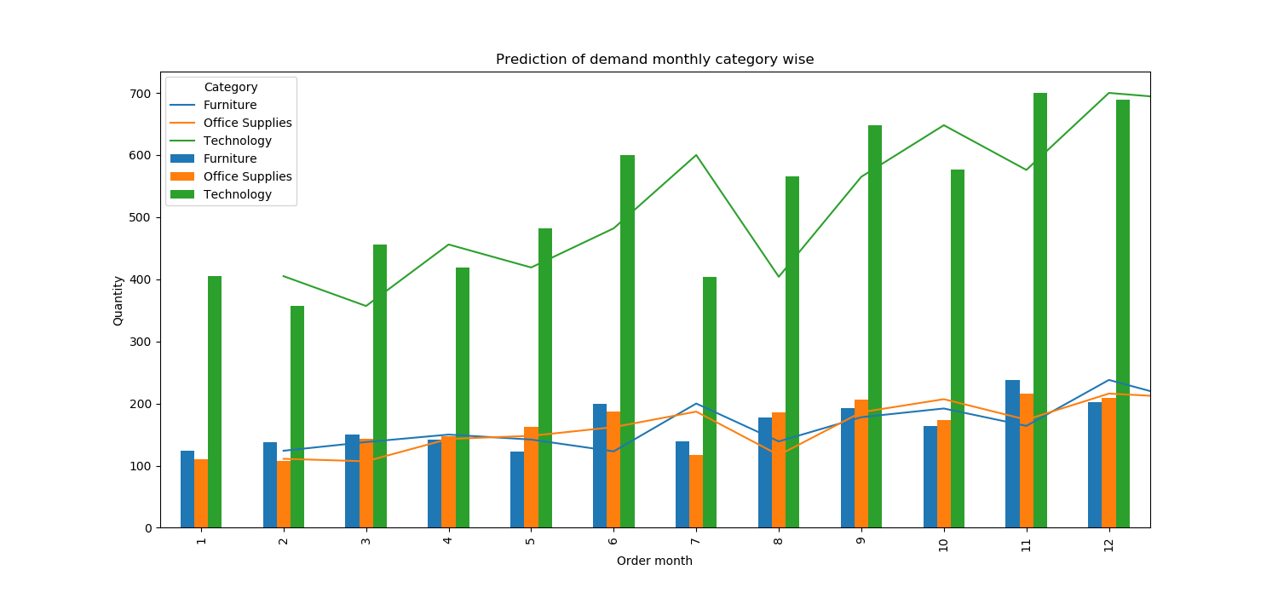
VisualizatioN 1: By Category
Plotted the test data of the XGB model to visualize the prediction demand and actual data by grouping categories for each month of order.
Line Graph – Predicted Quantity Count on a monthly basis for category Furnitures,Technology and Office Supplies.
Bar Graph – Actual Values of Target ´Quantity` was plotted monthly for the same categories.

Slide 16
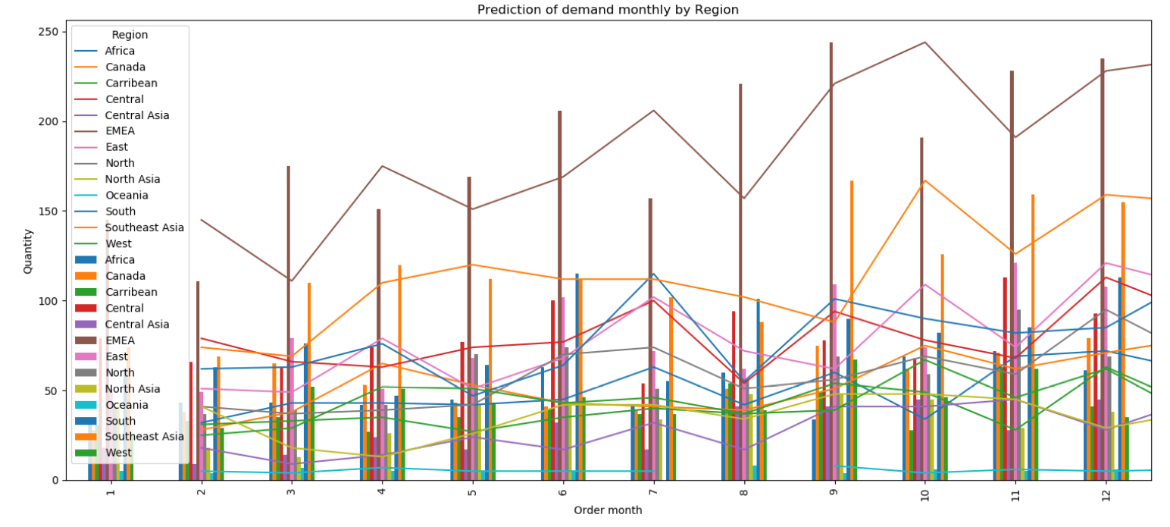
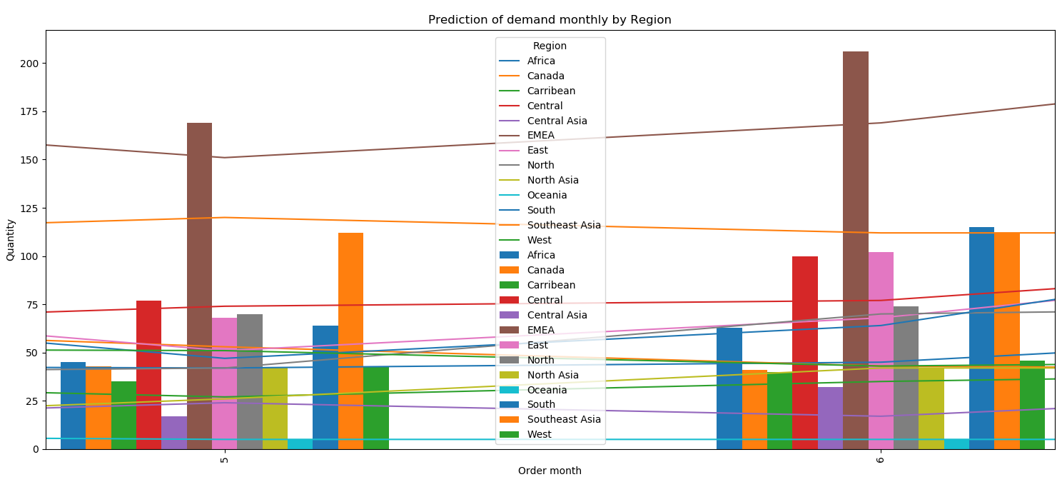
Visualization 2 : By Region
Predicting demand for each month and grouping region wise for all regions from 0 – 12
South, North, Asia, Central, EMEA, Africa, Caribbean, West East, Central Asia, North Asia, Oceania

Slide 17
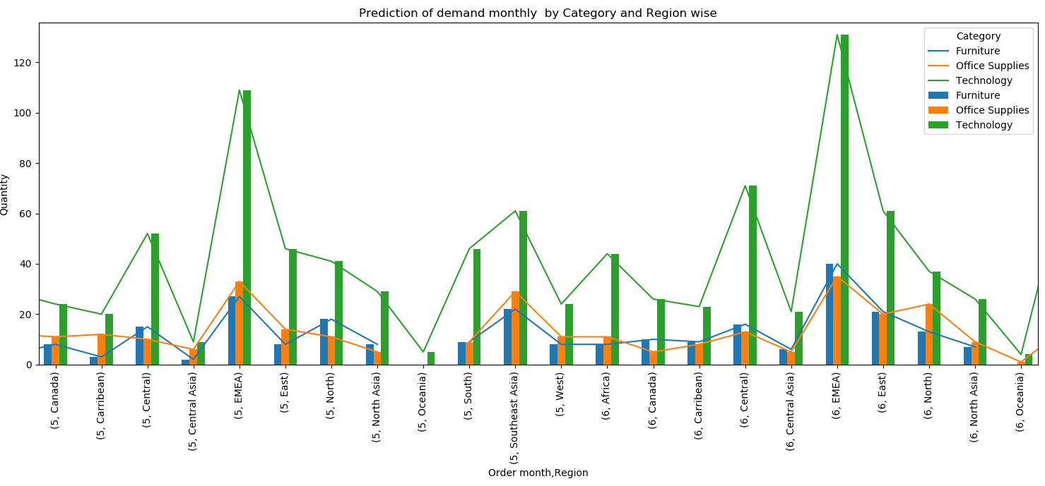
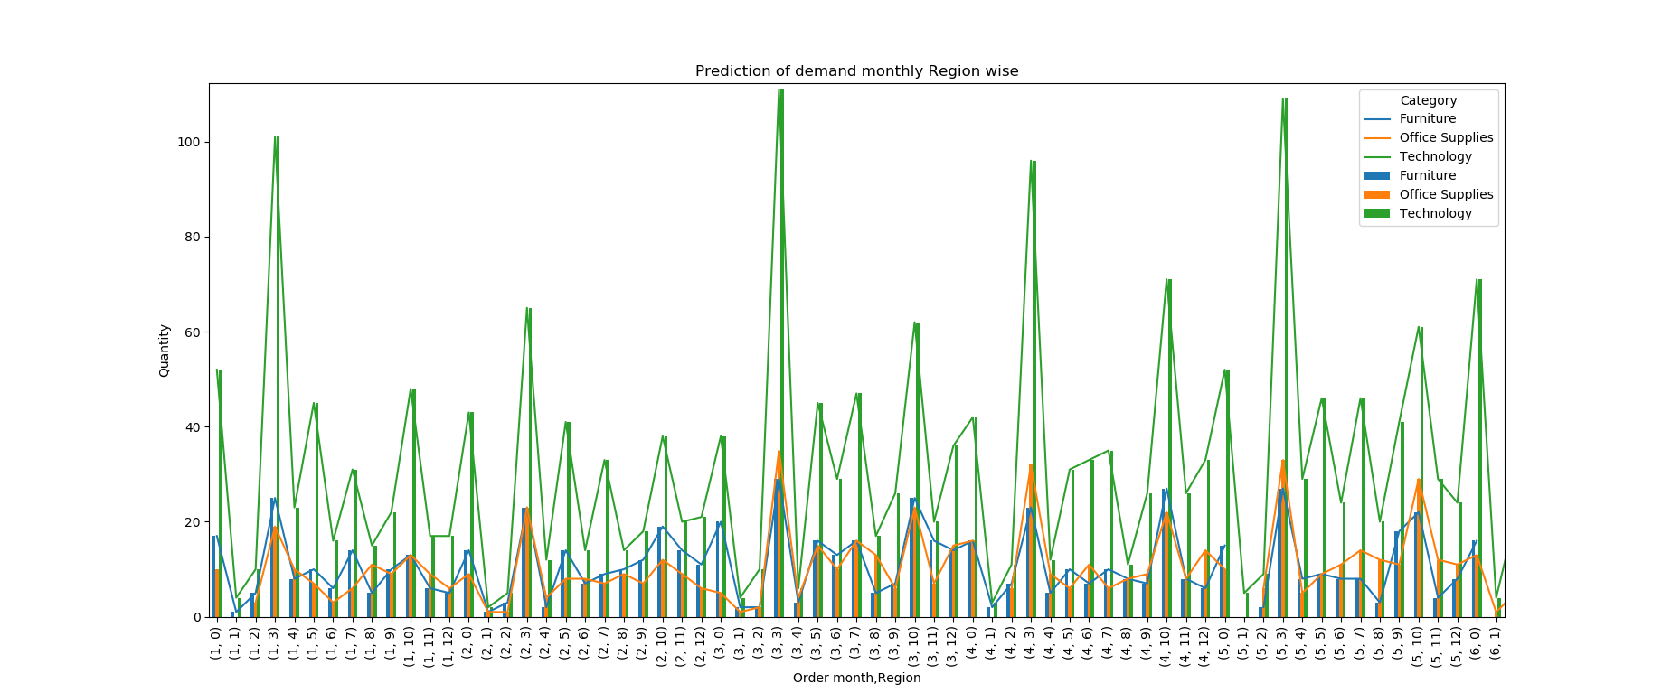
Visualization BY: ORDER MONTH, Region, Category

Slide 18
Project Plan / Time Plan
2 developers would be needed for the complete project
A tentative schedule for the project is given below
Weeks/ Milestones | 1 | 2 | 3 | 4 | *Buffer
Business Understanding
Data Understanding
Data Preparation - Preprocessing, Cleaning, Feature Engineering (Phase1)
Data Modelling (Phase2)
Evaluation, Testing , Documentation before production
Deployment (Phase3)
Warranty Support

Slide 19
Conclusion and future scope
From the given business use case and research : XGB Regression Algorithm performed well on the data and gave a 67% performance accurate results for the preidction of product demand.
Product demand was predicted in groups of various categories,region and visualizations were done.
Accoring to this use case, though there were only slight variations from actual values, the following was the order
November > December > June
Scope: Could be extended to Timeseries analysis, checking for seasonality and stationarity of data flow.
Performance can be increased by testing other algorithms along with hyper parameter tuning.
Technology Technology Tech
Furniture > Office Supplies > Office
Office Supplies Furniture Furniture
EMEA > Canada, Southeast Asia > South, Africa

Slide 20
Thank you ☺

